Slide 1
Data as a Service:
Model Serving & Management
Speaker: Yu-Ting Hsiao, PhD
Model Lifecycle Ops

Slide 2
Before we dig into model lifecycle ops…

Slide 3
The model lifecycle ops mainly sits on the process: step 3, and step 5 to 8.

Slide 4

The model lifecycle ops mainly sits on the process: step 3, and step 5 to 8.
serving, restful API
model management
Model as an image
model registry

Slide 5
The main purpose of model lifecycle ops is to
reduce stress of data scientists and data engineers
item | AS IS | TO BE
Trained model hyperparameter management? (Step 3)
Model version awareness? (Step 5)
Rocket template free? (Step 6)
Serving model for real time prediction (Step 7)
Serving model performance monitor? (Step 8)

Slide 6


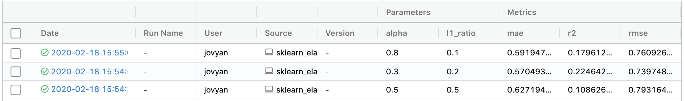
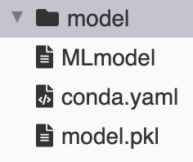
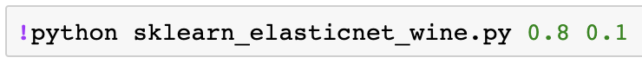
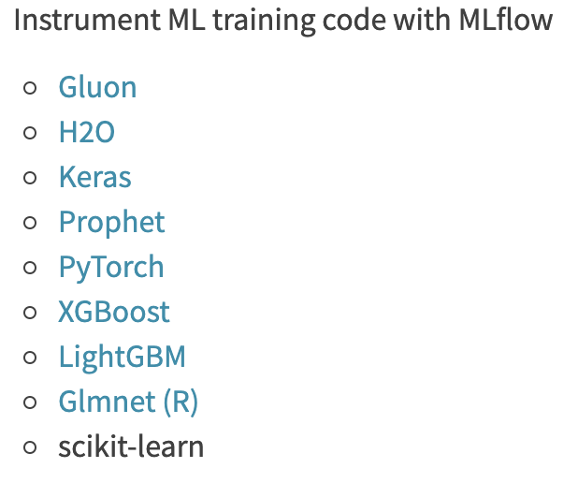

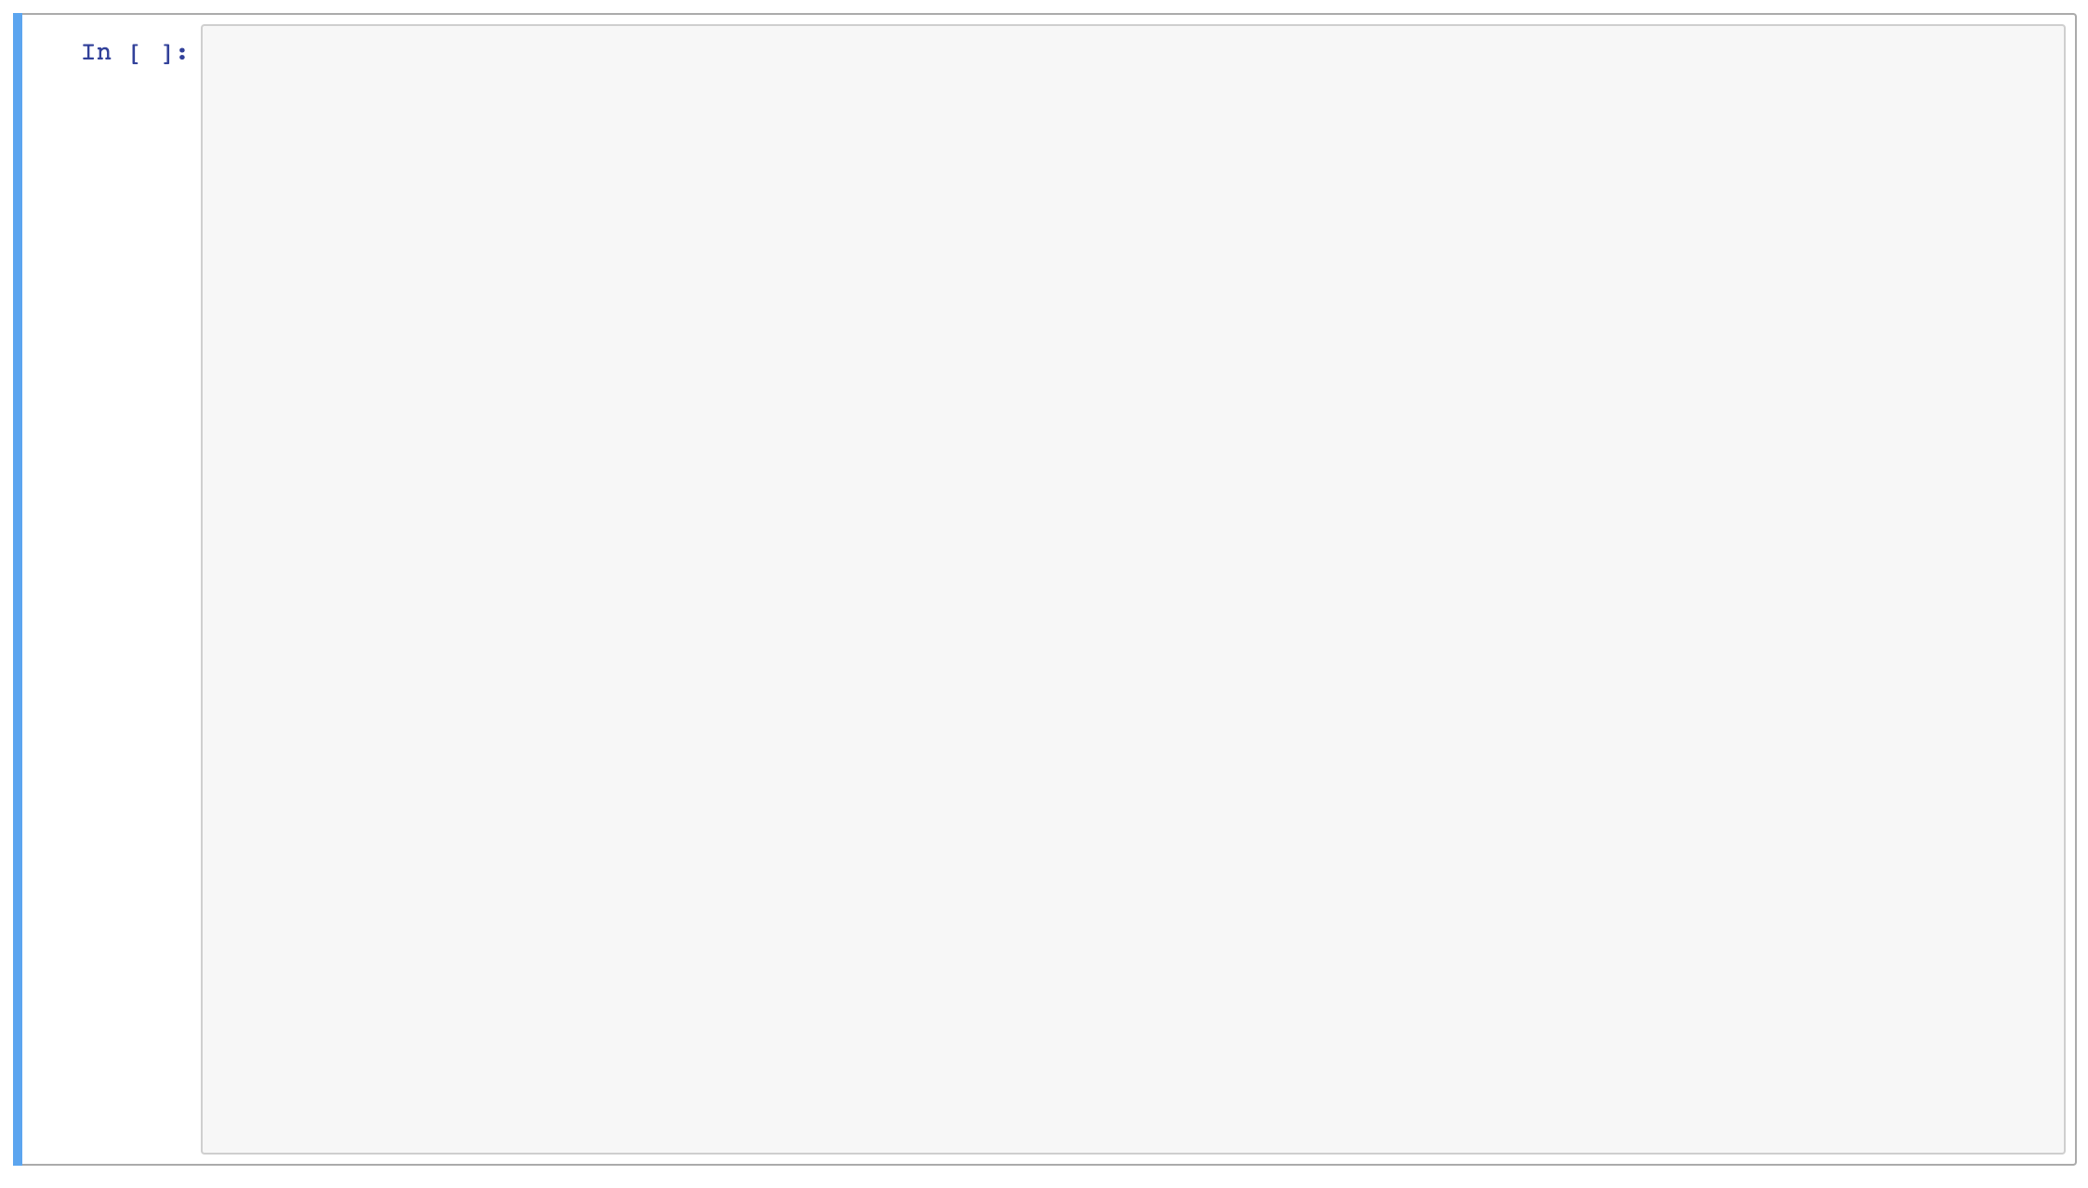
Model Lifecycle Ops
Explorer node
Log your model
build a model:
Production env
1. import mlflow
Write a yaml (json) file:
Create an image and
register it to HARBOR.
2. load basic mlflow parameters
3. write your model
Write a yaml (json) file:
4. log your hyperparameters
5. log your model
Model is ready to serve
Worldwide env
Restful API
serving

